Slide 1
Waves: An Intro
Chimken MacNugett

Slide 2
What is a wave?

Slide 3
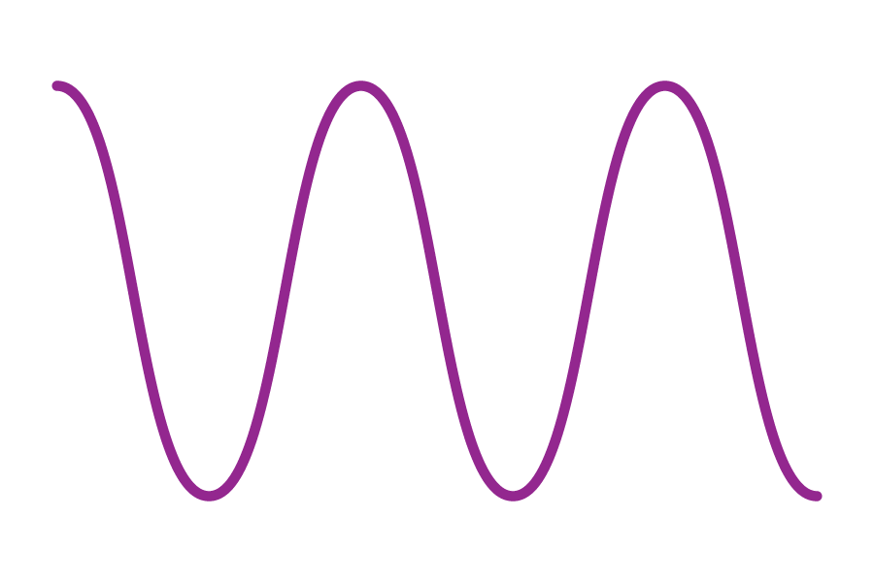

What is a Wave?
Waves: Waves transport energy without the transfer of matter. But what does that mean?
What are some types of waves?
There are a lot:
Sound Waves
Light (Electromagnetic Spectrum
Heat energy
Radiation
And much much more

Slide 4
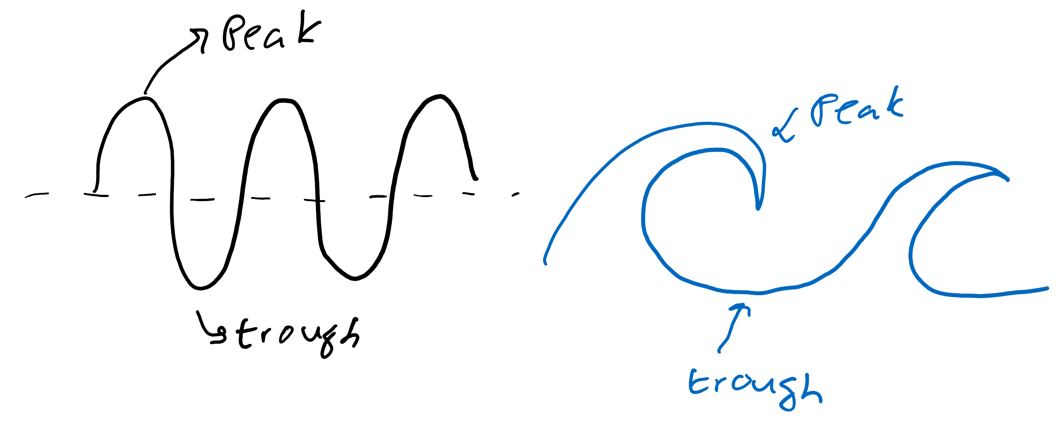
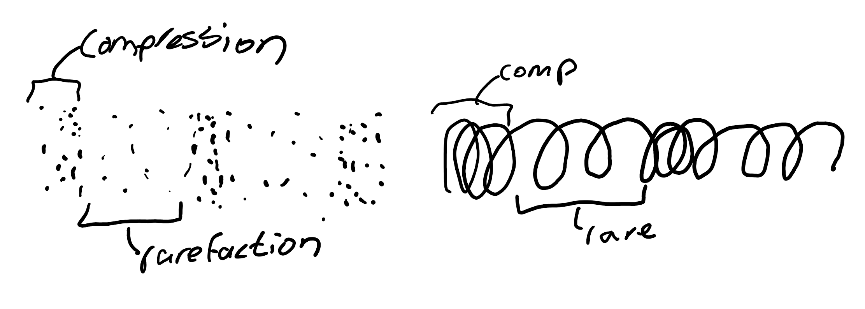
What does a wave look like?
Transverse waves
They do the up and down
Vroom, drop, vroom, drop, etc.
Longitudinal waves
They do the back and forth
Squish, unsquish, squish, unsquish, etc.

Slide 5
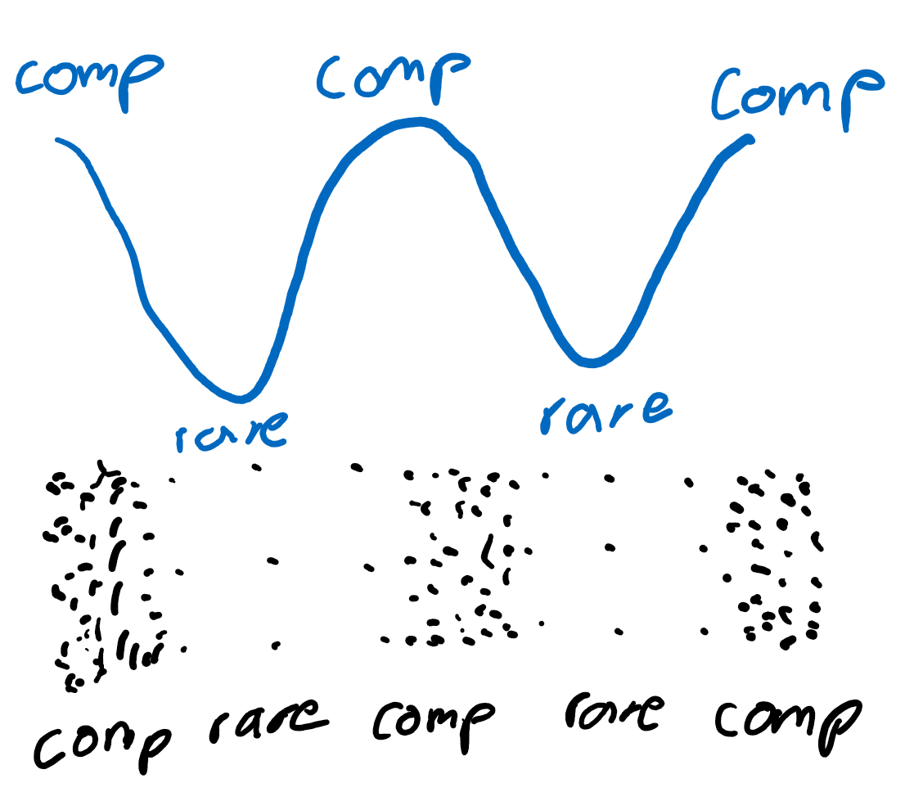
Expressing longitudinal waves
Compressions and rarefactions are hard to show on paper
We can draw longitudinal waves in a way similar to transverse waves!

Slide 6
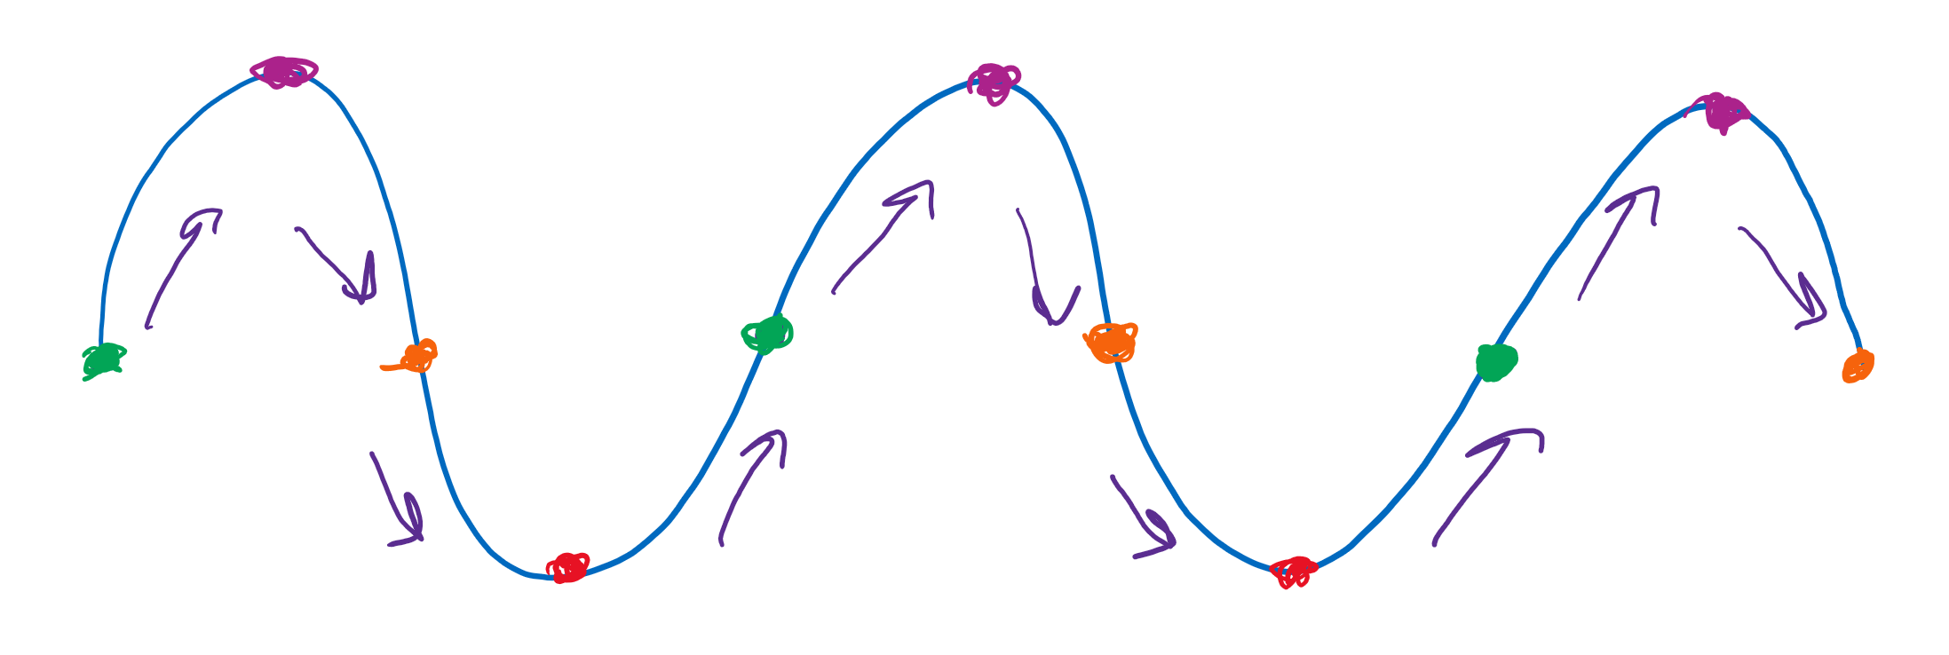
What is a “squiggle?”
A squiggle (cycle) is the segment from the same color to the next same color (aka, red to red or orange to orange to orange). After one cycle the next cycle looks the exact same. Repeat repeat repeat.

Slide 7
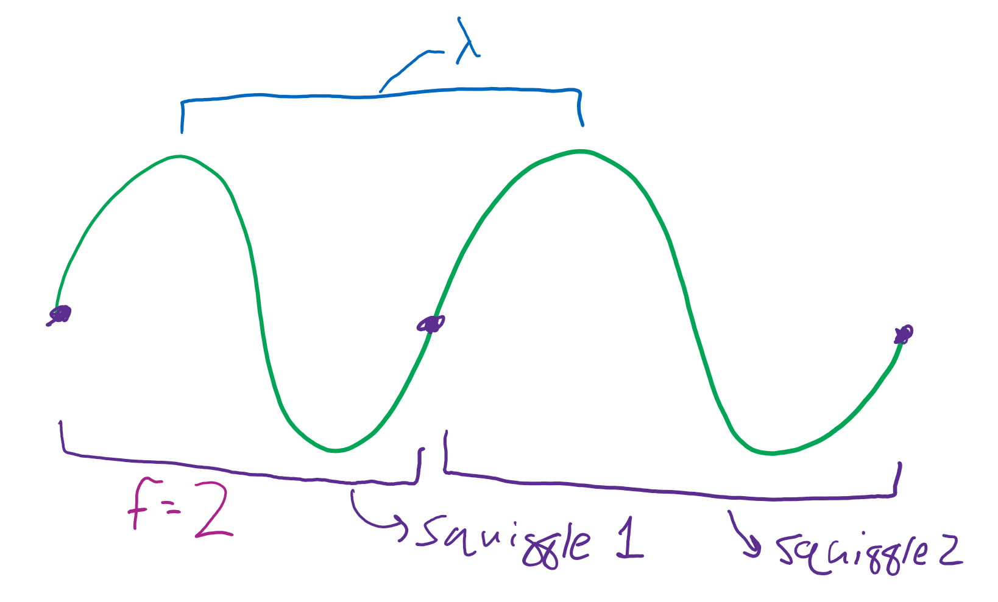
Frequency and wavelength
Frequency (f): number of squiggles per second. Measured in “hertz.” Units for “hertz” is 1/s.
Wavelength (λ): length of squiggle. Measured in meters.

Slide 8
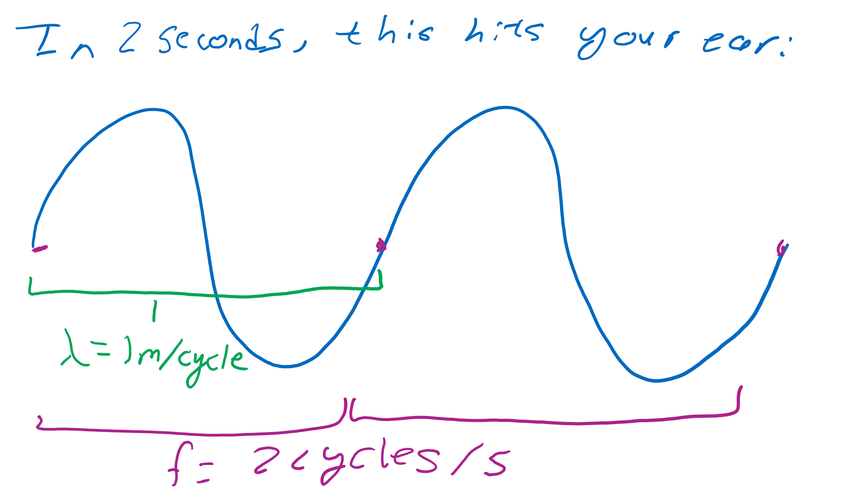
More about the two
Wavelength
Measured as the distance between peaks or distance between troughs.
Also the length of a cycle.
Frequency
How many cycles occur in a given time
# of cycles divided by time.
*that should say f = 2 cycles / 2 seconds

Slide 9
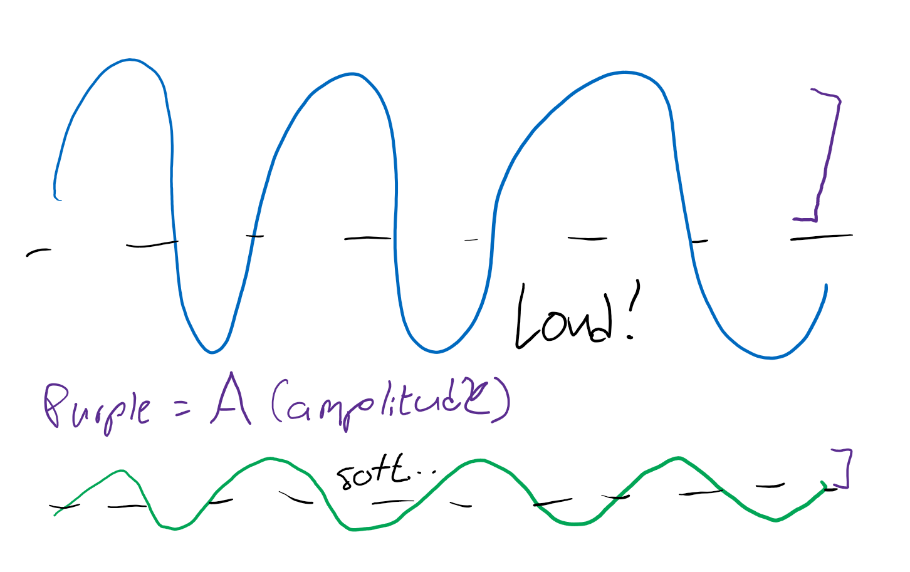
Energy (amplitude)
Amplitude
How “tall” a wave looks
Determine the “strength” of the wave
High amplitude sound waves are loud
High amplitude light waves are “bright”

Slide 10
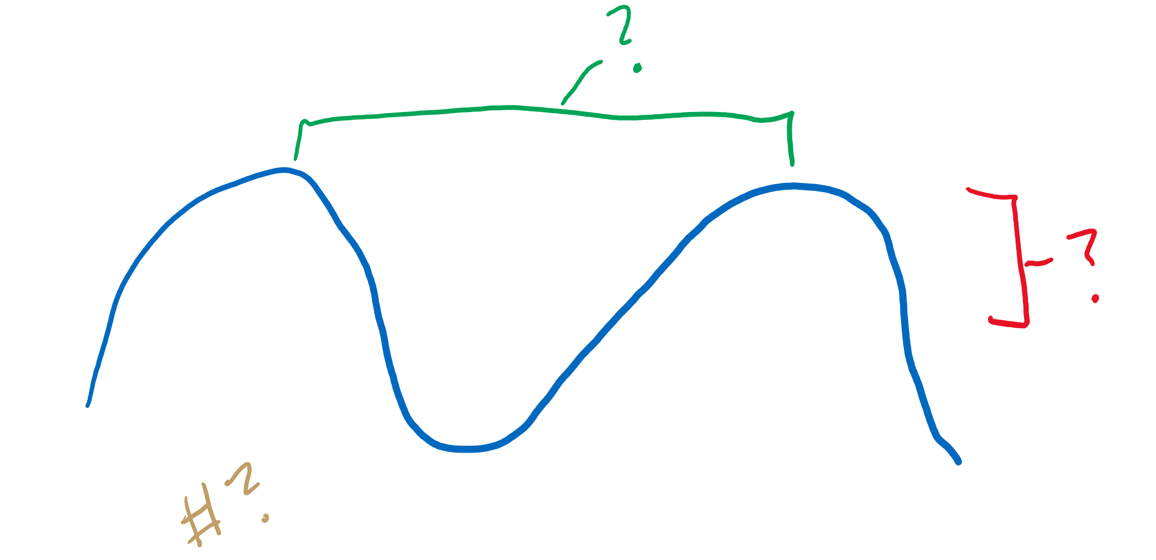
Review
What are some waves you know?
What is wavelength?
Frequency?
Amplitude?
Insert pic here of kool epikk gamer things

Slide 11
Reflection

Slide 12
Where do we see reflection?
Mirrors
Puddles
Bubbles
Spoons
Etc.
Reflection is just a wave “bouncing back” at you

Slide 13
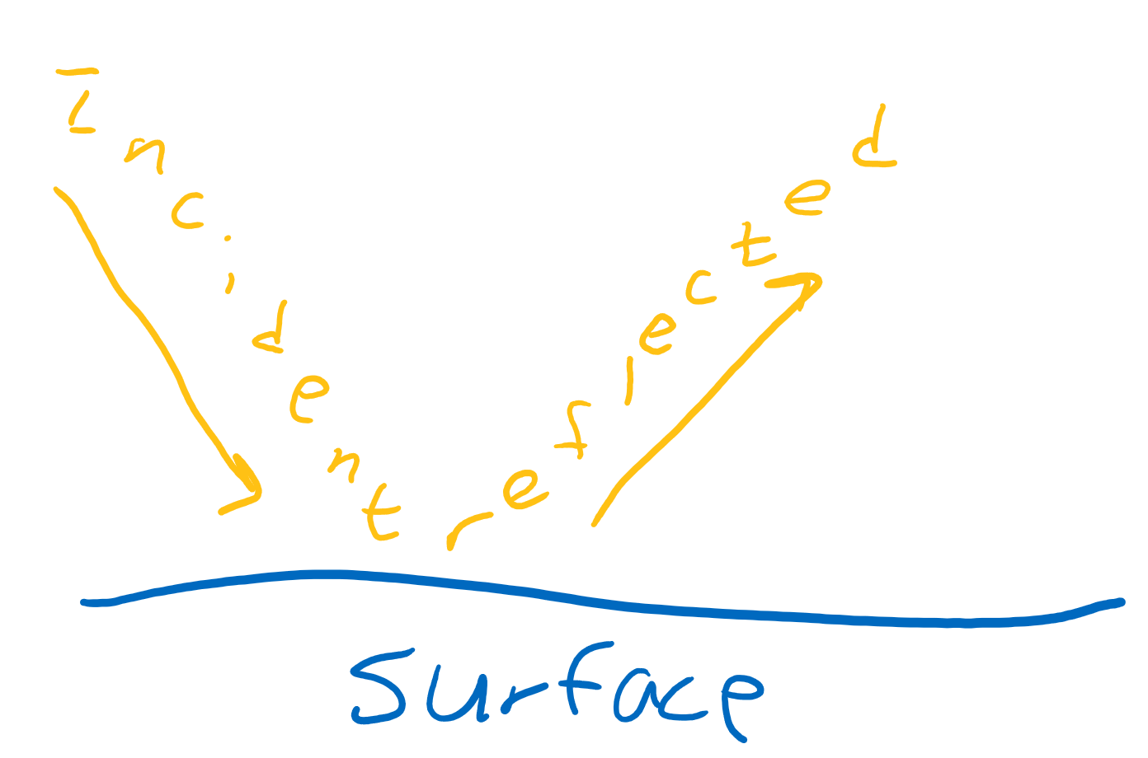
Naming the things
Surface:
The thing that does the reflecting
Incident:
Refers to the wave before it gets reflected
Reflected:
Refers to the wave after the reflection

Slide 14
Reflection

Slide 15
Where do we see reflection?
Mirrors
Puddles
Bubbles
Spoons
Etc.
Reflection is just a wave “bouncing back” at you

Slide 16
Naming the things
Surface:
The thing that does the reflecting
Incident:
Refers to the wave before it gets reflected
Reflected:
Refers to the wave after the reflection

Slide 17
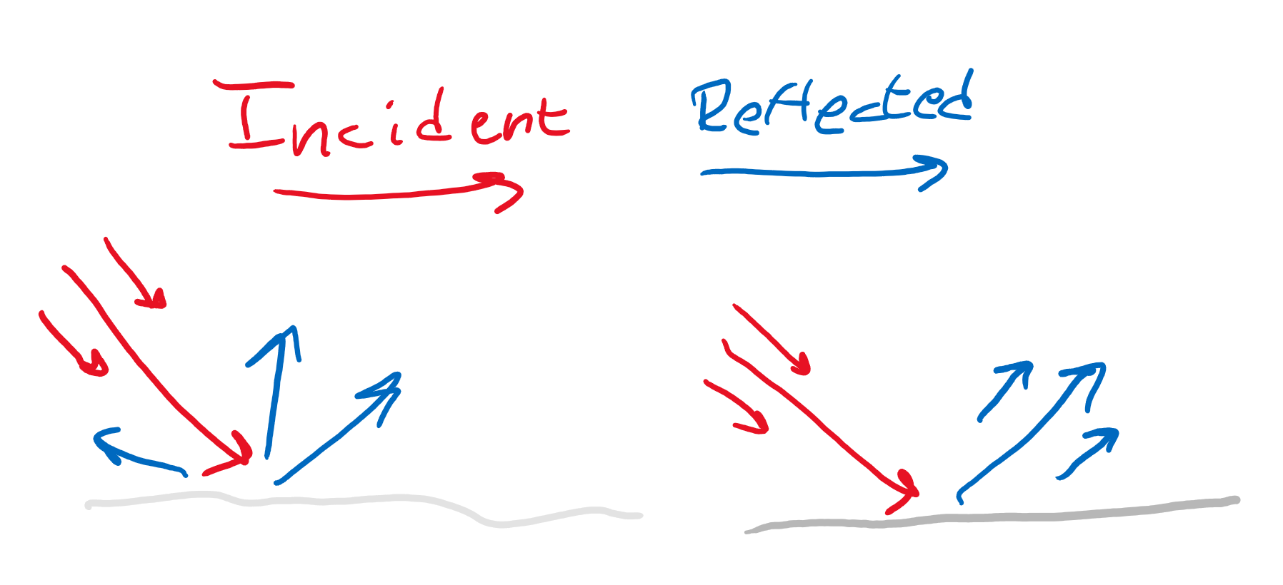
Types of surfaces
Diffuse reflector:
Waves bounce everywhere
No set direction
Specular reflector:
Special rules
Bounce in orderly fashion

Slide 18
Types of surfaces
Diffuse reflector:
Waves bounce everywhere
No set direction
Specular reflector:
Special rules
Bounce in orderly fashion

Slide 19
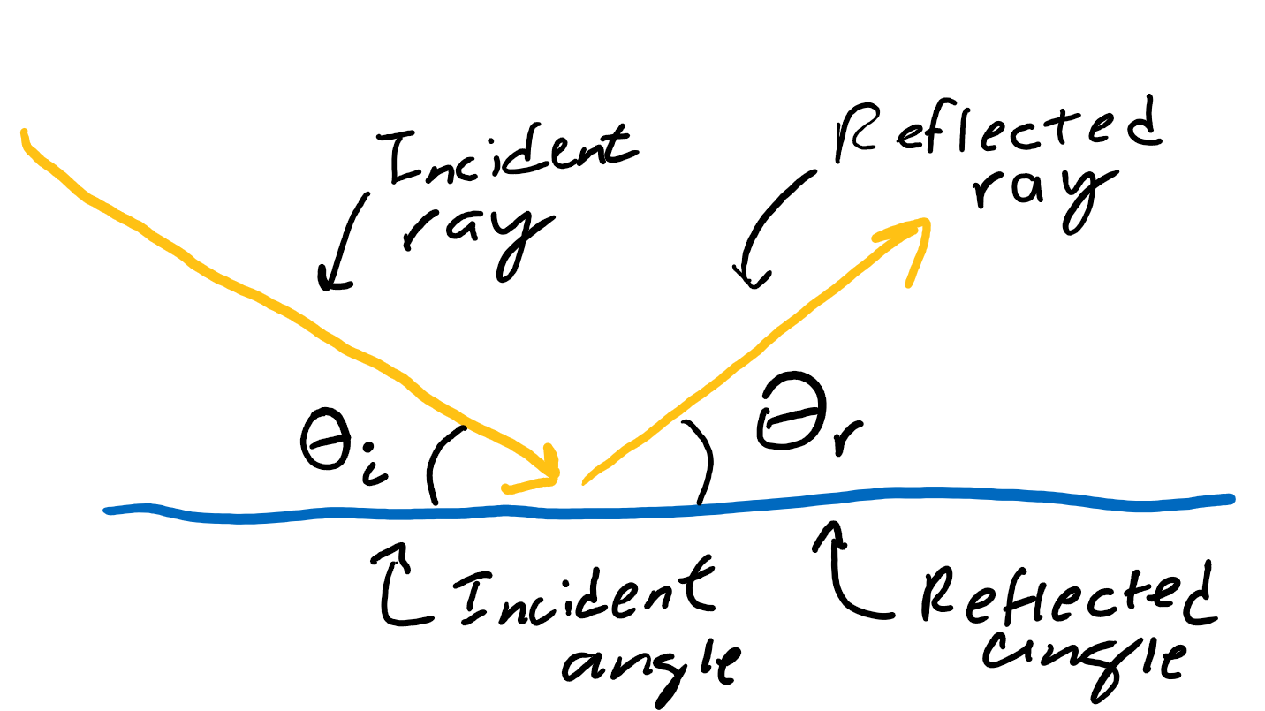
Doing the math (specular reflectors)
Angle of incidence
The angle at which the wave comes in
Angle of reflection
The angle at which the wave goes out at
These two angles are equal in measure

Slide 20
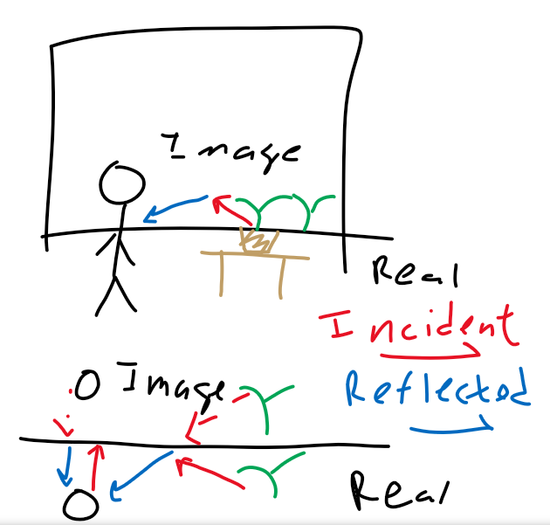
The “image”
On a flat mirror, the image (or the thing we see reflected in the mirror) is always opposite of the actual object
The distance from the original/real object to the mirror is the same as that from the image to the mirror

Slide 21
What actually happens to the wave
Fixed end
Like a rope tied tight on a post
The wave “flips”
Mirrors
Free end
Like a rope sliding on a post
The wave just “comes back” at us

Slide 22
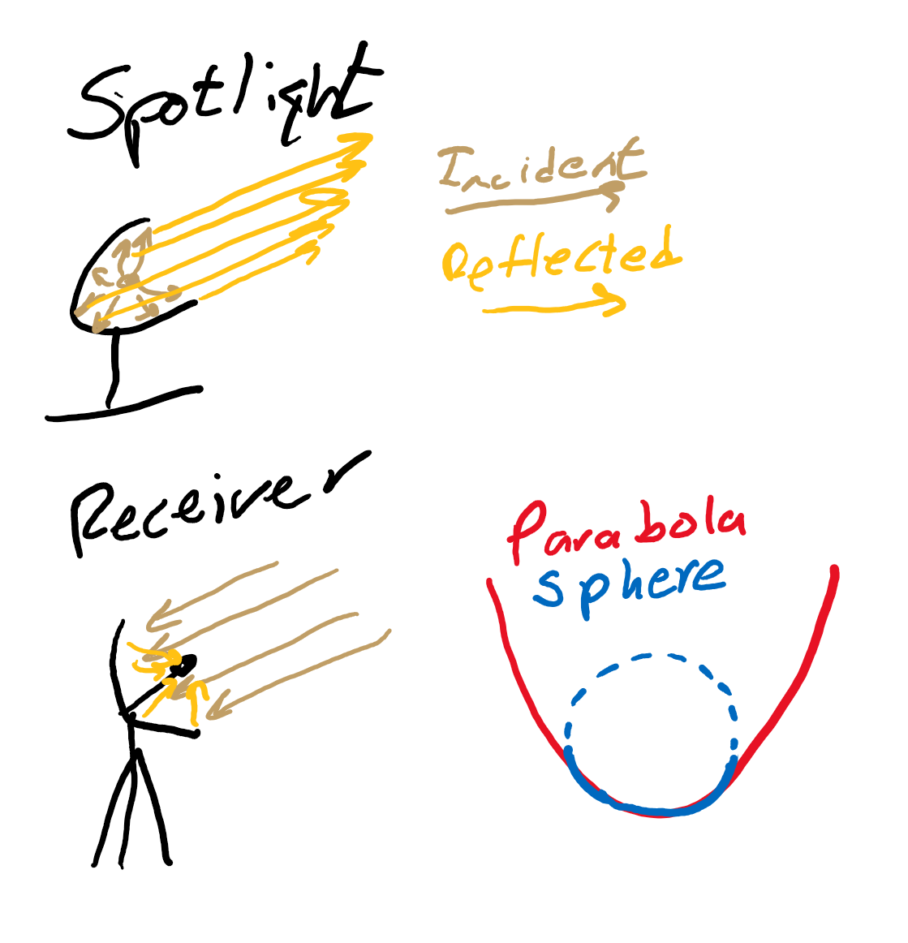
Parabolic reflectors
Parabolic
Reflect parallel rays into a certain point and vice versa
Spotlights shoot light in one direction
Antennae use them to reposition waves into the receiver
Spherical
Parabolic is hard to make, so spheres are used to approximate a parabolic reflector

Slide 23
Review
What is reflection?
What kinds of “reflectors” are there?
If I come in at an incident angle of 90 degrees, what’s my reflected angle?
On a flat mirror, where is the image?
What are some special types of mirrors?

Slide 24
Interference

Slide 25
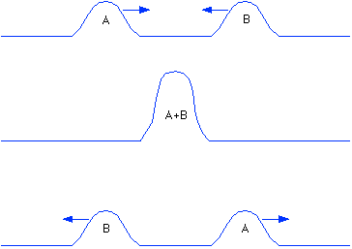
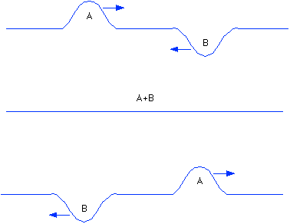
What is Interference?
In essence, it’s when waves interact with other waves
What will happen when the 2 sets of waves below collide?

Slide 26

2 Pebbles in a Lake
Waves are not all just single bumps
Repeated Ups and Downs
Many points of Addition and Subtraction

Slide 27
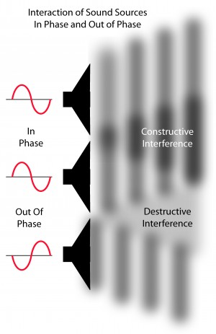
Constructive Interference
When waves add together
Amplitudes add, volume increases
The height of the wave increases
What happens with longitudinal waves?
The 2 waves come at each other as compressions, and at the point they meet, they are doubly compressed before moving on.

Slide 28
Destructive Interference
When to opposite waves “add” to each other
Amplitude drops/goes to 0
Creates a softer tone
What happens with Longitudinal waves?
The high pressure areas of one wave coincide with the low pressure areas of another wave, thus when they pass, pressure balances out

Slide 29
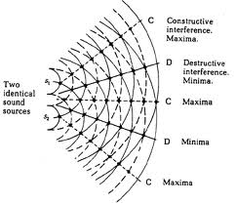
On a Larger Scale
Consider the 2 sources
What happens as you travel along in the room?
The sound grows and diminishes as you walk by since there are bands of constructive interference and bands of destructive interference

Slide 30
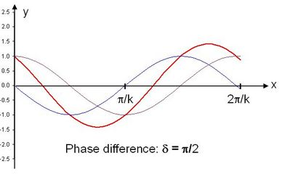
In Phase and Out of Phase
In Phase: Perfect Constructive Interference
Out of Phase: Perfect Destructive Interference
Somewhere in Between:
90 Degrees out of phase

Slide 31
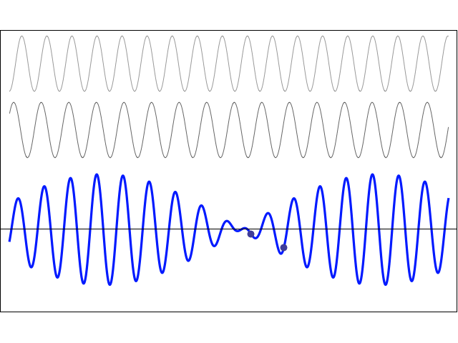
When Waves have Differing Frequencies
So far, we’ve only seen waves with the same frequency
What if they are different?
Constructively interferes at some points
Destructively interferes at others
Music?

Slide 32
Review
What is interference?
What is the difference between Constructive and Destructive interference?
What does it mean for 2 waves to be 180 degrees out of phase?
What happens when different frequencies interfere with each other?

